Slide 1
Slide 1 (Underlined words are hyperlinked to slides 2-5)
Excerpt from Martin Luther King Jr.
I Have a Dream Speech
Five score years ago, a great American, in whose symbolic shadow we stand today, signed the Emancipation Proclamation. This momentous decree came as a great beacon light of hope to millions of Negro slaves who had been seared in the flames of withering injustice. It came as a joyous daybreak to end the long night of their captivity.

Slide 2
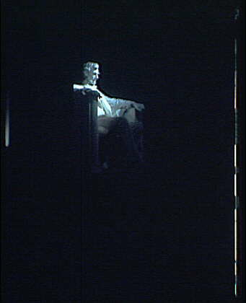
Slide 2
Symbolic Shadow
“Symbolic means it’s not a real shadow, but it represents something or someone. This reminds me of how small I felt when I stood next to the statue of Lincoln in Washington, DC.”
Photo from memory.loc.gov

Slide 3
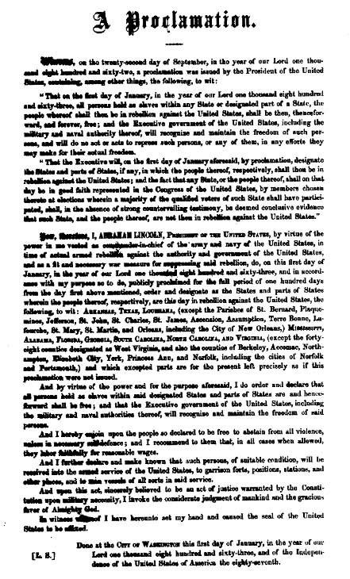
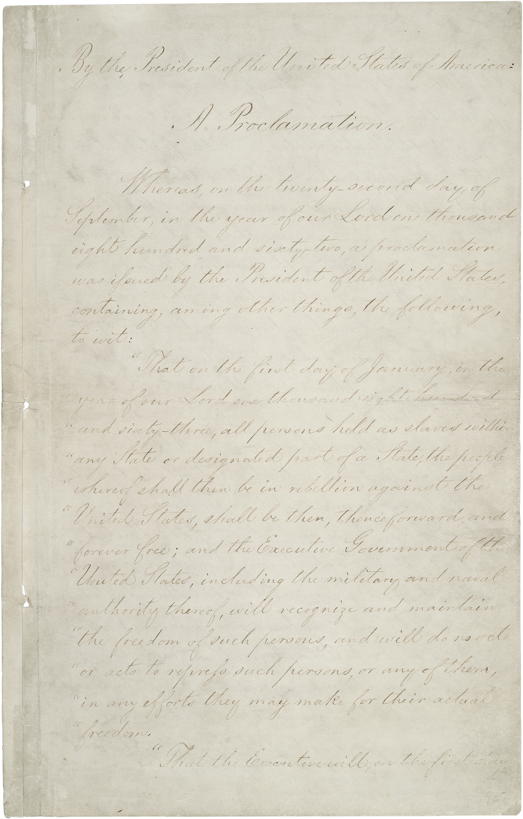
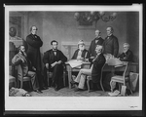
Slide 3
Emancipation Proclamation
Photos from memory.loc.gov

Slide 4
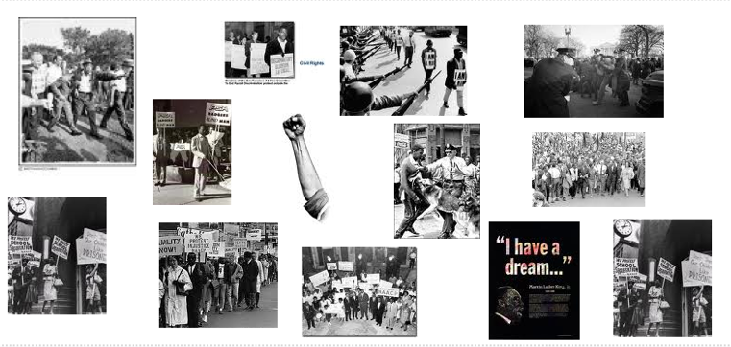
Slide 4
Withering Injustice
Collage Created in WordSift wordsift.com

Slide 5
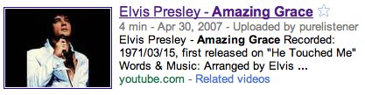
Joyous Daybreak
Slide 5
“This song reminds me of the importance of freedom for all people.”

Slide 6
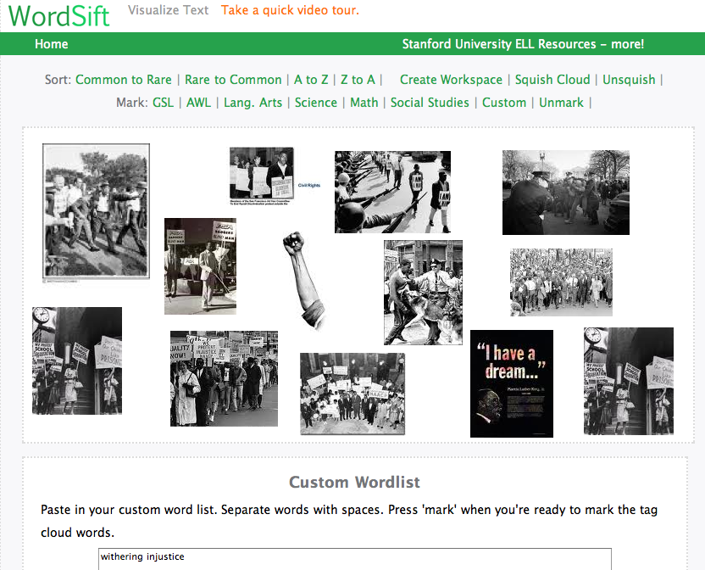
Word Sift Collage (the means by which the collage was created)
for our reference

